Slide 1
Chapter 16
The Autonomic Nervous System
Sympathetic (Thoraco-lumbar) division
Parasympathetic (Cranial-sacral) division

Slide 2
Somatic Motor vs Visceral Motor
Somatic motor is directed from cortical levels to skeletal muscles and is voluntary.
Visceral motor is directed from hypothalamus and midbrain and is involuntary, but has input from cortex and thalamus.
Somatic lower motor neuron is in ventral horn of gray matter and neurotransmitter at skeletal muscle is Ach.
Visceral motor comes from cranial nerves or intermediolateral gray horn, involves 2 neurons and the neurotransmitter is either Ach or NE at either cardiac muscle, smooth muscle or glands.

Slide 3
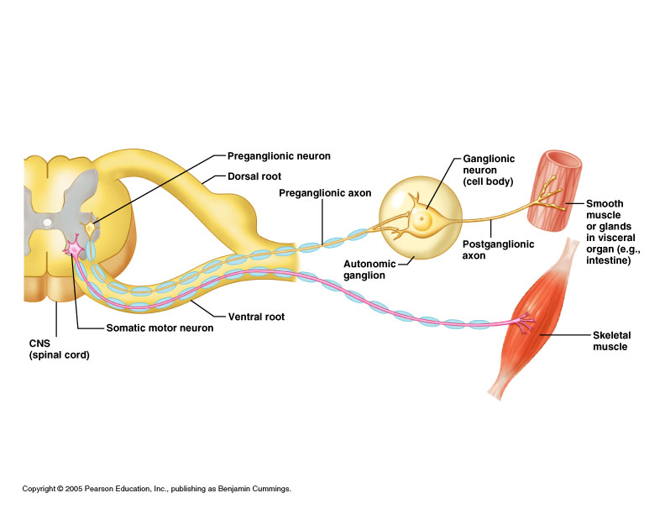
Somatic motor vs Visceral motor

Slide 4
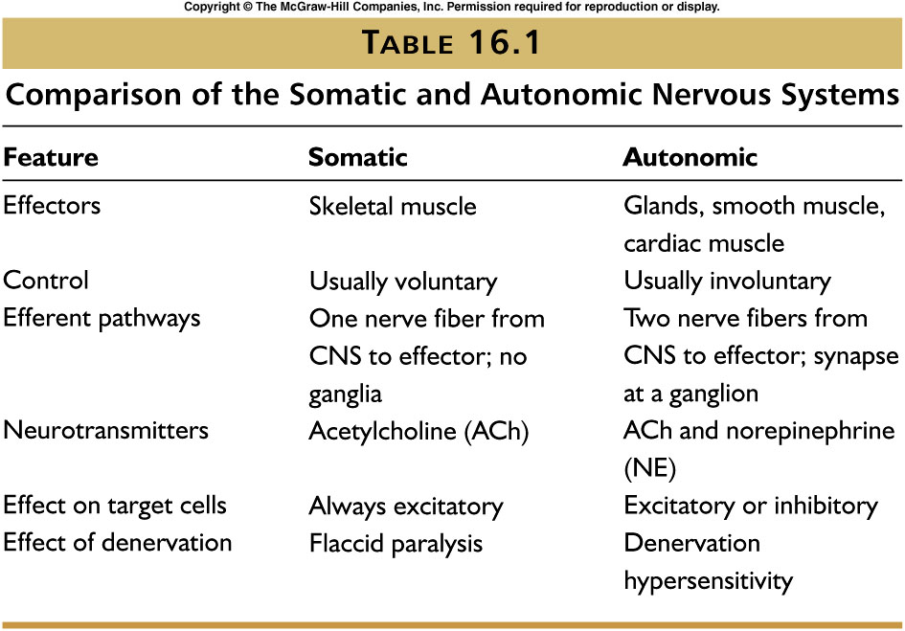

Slide 5
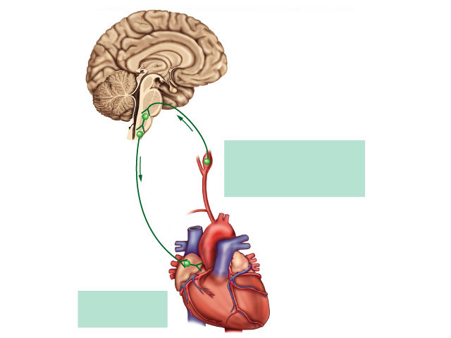
Visceral reflexes
Unconscious automatic control of visceral activities.
Increased BP
HR decreases

Slide 6
Autonomic Nervous System
Motor nervous system to visceral organs
Two divisions:
1. Sympathetic “Fight, Fright, or Flight”
-Derived from thoracic and lumbar spinal nerves
2. Parasympathetic “Rest, Digest, and Reproduce”
-Derived from cranial and sacral nerves

Slide 7
Sympathetic division
Arise from Thoracic-Lumbar spinal nerves T1-L2
Preganglionic neurons (myelinated)- relatively short
  Cell bodies are located in intermediolateral gray column of thoracic and lumbar vertebrae.
  Pregnaglionic neurons exit via ventral root → into white ramus communicans → synapse with postganglionic axon in peripheral ganglion at same level or another level.
  Neurotransmitter is acetylcholine.
Postganglionic axons (unmyelinated)- relatively long
  -Cell bodies in peripheral ganglia extend to visceral organs
  Distribution is widespread
  Neurotransmitter is norepinephrine

Slide 8
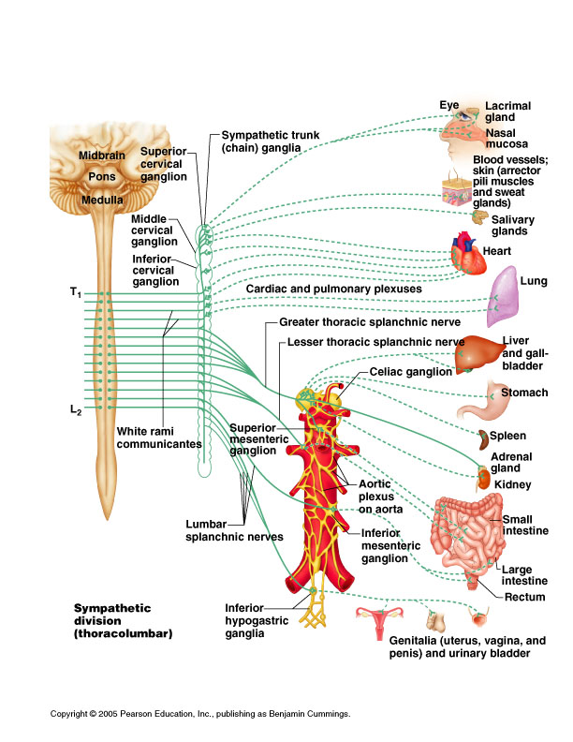
Sympathetic division

Slide 9
Sympathetic ganglia
Sympathetic postganglionic neuron arises from either:
Paravertebral sympathetic chain ganglia.
Superior, middle or inferior cervical ganglion.
Coeliac ganglion
Superior and inferior mesenteric ganglion
Inferior hypogastric ganglion
Neurotransmitter is Norepinephrine (NE), except on adrenal medulla where it is Ach.

Slide 10
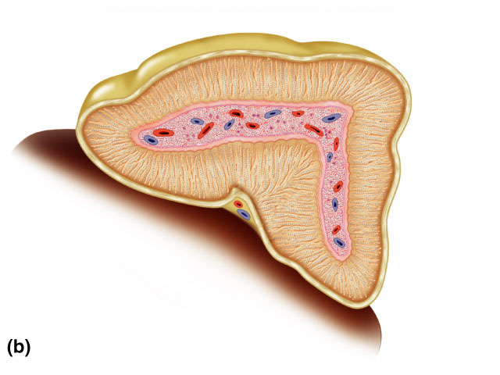
Adrenal glands
Located on superior pole of each kidney
Outer layer is cortex; central core = medulla
Adrenal medulla is a modified postganglionic sympathetic ganglion that secretes epinephrine and norepinephrine (80%/20%) when stimulated.
Adrenal cortex outer layer
Adrenal medulla inner core

Slide 11
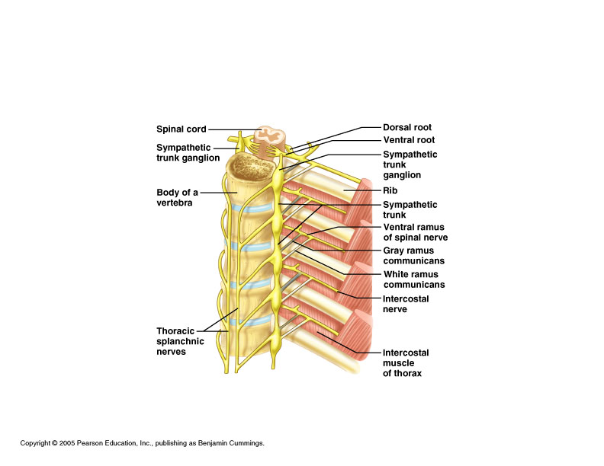
Spinal nerves and paravertebral ganglia

Slide 12
White Ramus and Gray Ramus Communicans
White ramus communicans: All sympathetic preganglionic neurons enter the paravertebral ganglion chain via the white ramus communicans. They are white because the nerves are myelinated.
Gray ramus communicans carry unmyelinated postganglionic sympathetic nerves to peripheral organs. They are gray because they are unmyelinated.

Slide 13
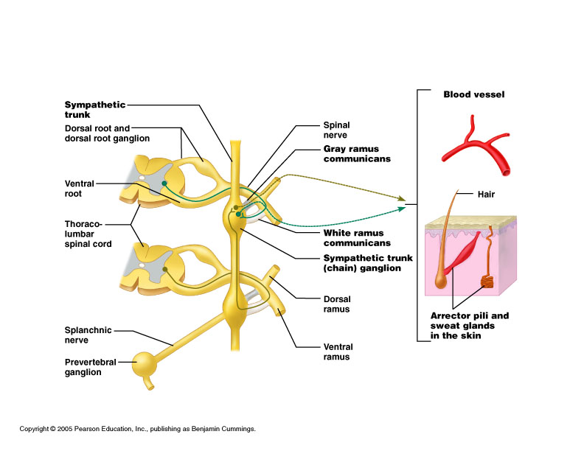
White Ramus and Gray Ramus Communicans

Slide 14
Sympathetic preganglionic neuron routes
Preganglionic neurons may do 1 of 3 things:
Enter the paravertebral ganglion at same level via white ramus communicans and synapse there.
Enter paravertebral ganglion and either ascend or descend to another level to synapse at that level.
Pass through the paravertebral ganglion via the white ramus communicans and synapse in a prevertebral ganglion.

Slide 15
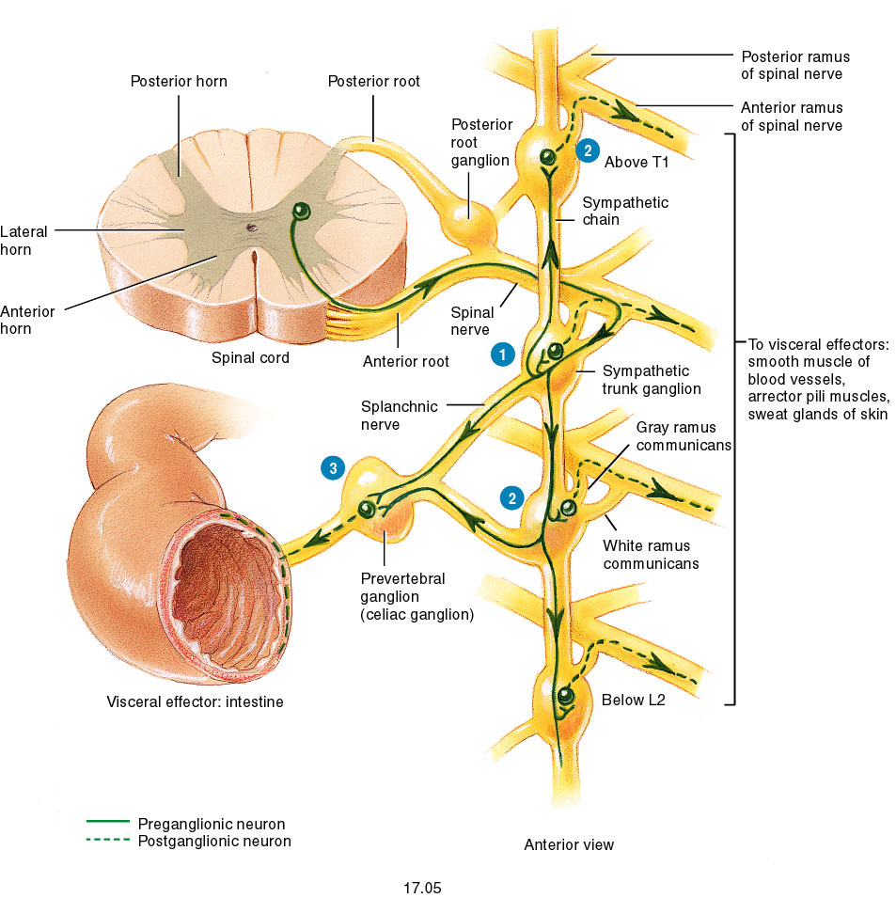
Preganglionic neuron routes

Slide 16
Sympathetic ganglia

Slide 17
Parasympathetic divison
Cranial/sacral origin; CN- III, VII, IX and X; S2-S4
Preganglionic neurons (myelinated)- relatively long
- synapse with postganglionic axons in ganglia close to organs
- neurotransmitter is acetylcholine.
Postganglionic axons (unmyelinated)- relatively short
  - neurotransmitter is acetylcholine
  Distribution is more specific and less diffuse than sympathetic

Slide 18
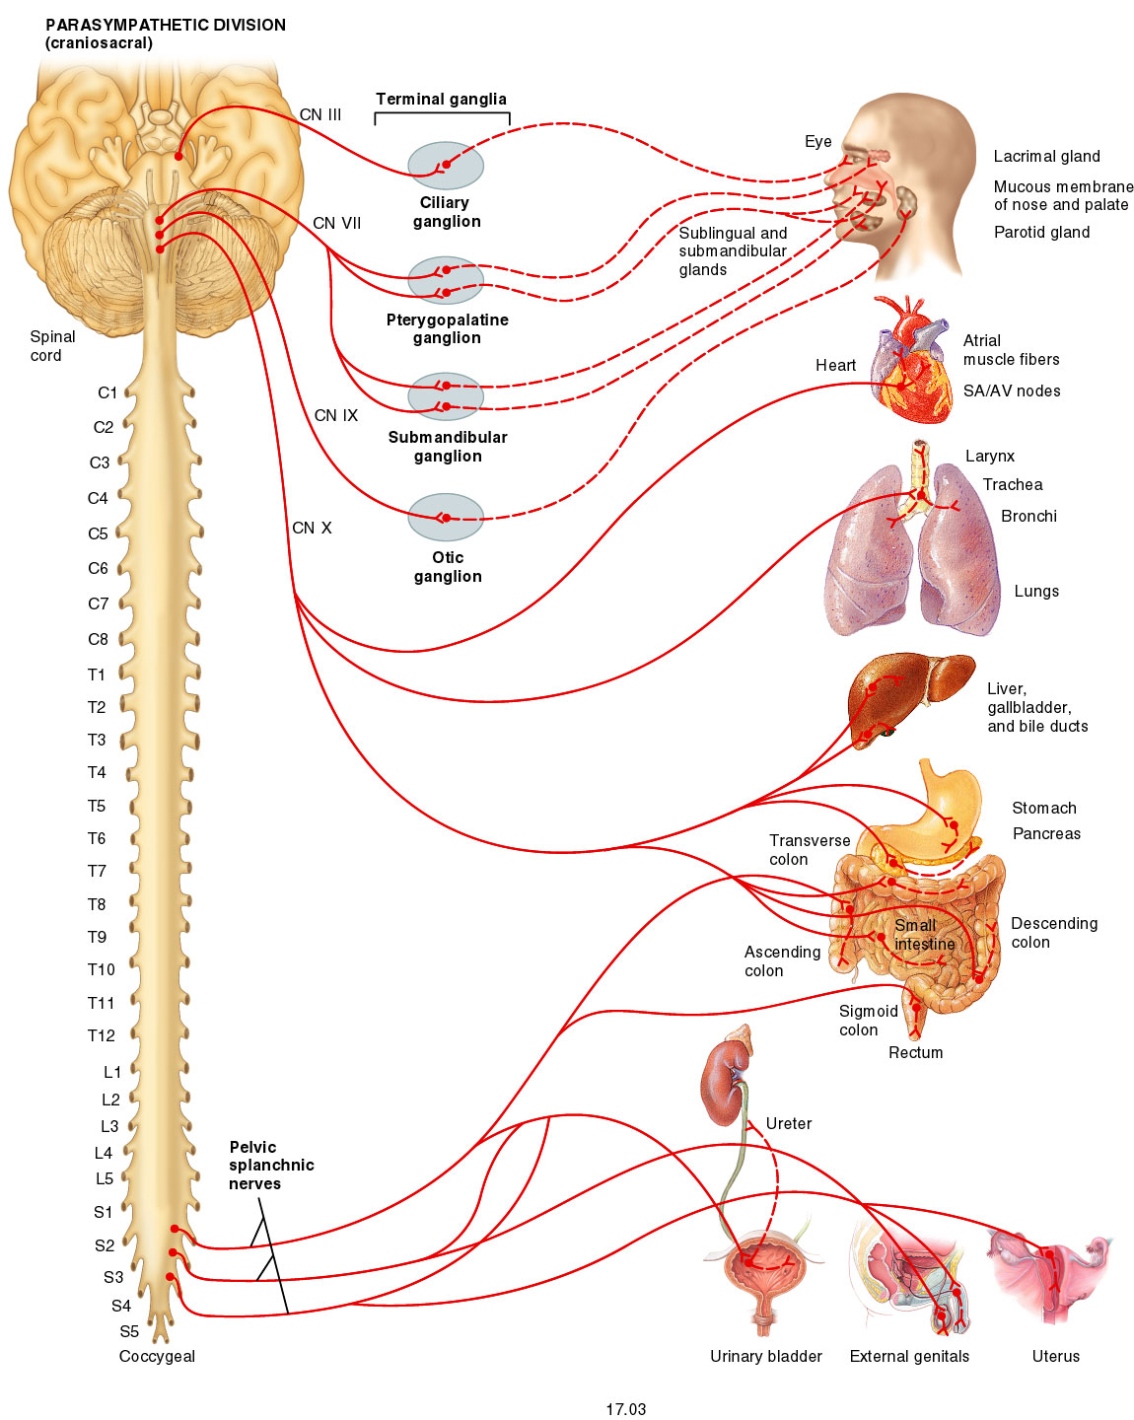
Parasympathetic
division

Slide 19
Parasympathetic ganglia
CN III = Ciliary ganglion → eye
CN VII = Pterygopalatine and submandibular ganglion → eye and nasal mucosa
CN IX = Otic ganglion → parotid salivary gland
CN X = To ganglia on each organ (heart, lungs, stomach, pancreas, liver, spleen, small and large intestine, rectum, kidneys and urinary bladder).
S2-S4 = To large intestine, rectum, genitalia, ureters, and urinary bladder
Neurotransmitter is Ach at pre and postganglionic synapses

Slide 20
Sympathetic vs Parasympathetic
Most organs have dual innervation
In general the actions of one system opposes those of the other. Ex. Eye; PS →constrict; Sym → dilation
Both divisions are cooperative in salivary glands
Predominant tone is parasympathetic in most organs.
Sym. tone exists solely in adrenal med., sweat glands, piloerector muscles of skin, and many blood vessels.
Sympathetic distribution tends to be more diffuse whereas parasympathetic is more specific.

Slide 21
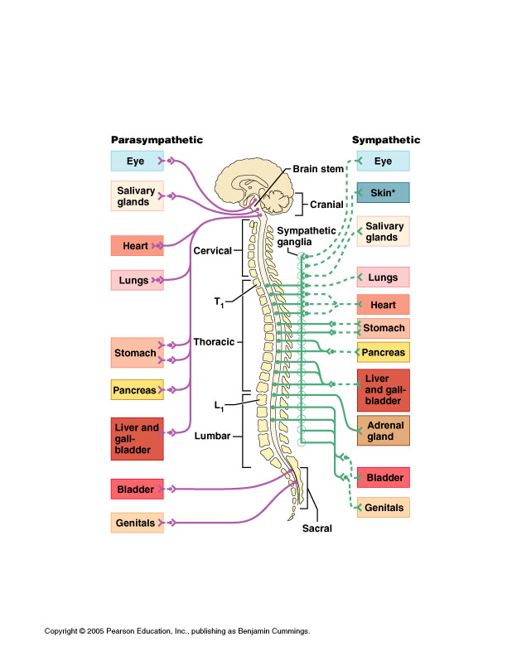
Overview of dual
innervation of
Sym vs Parasym.

Slide 22
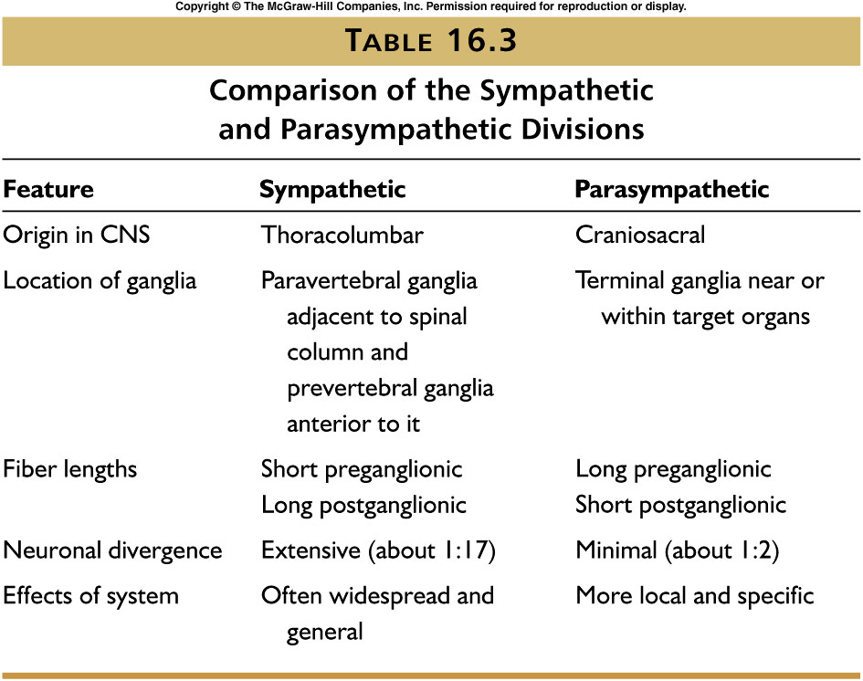

Slide 23
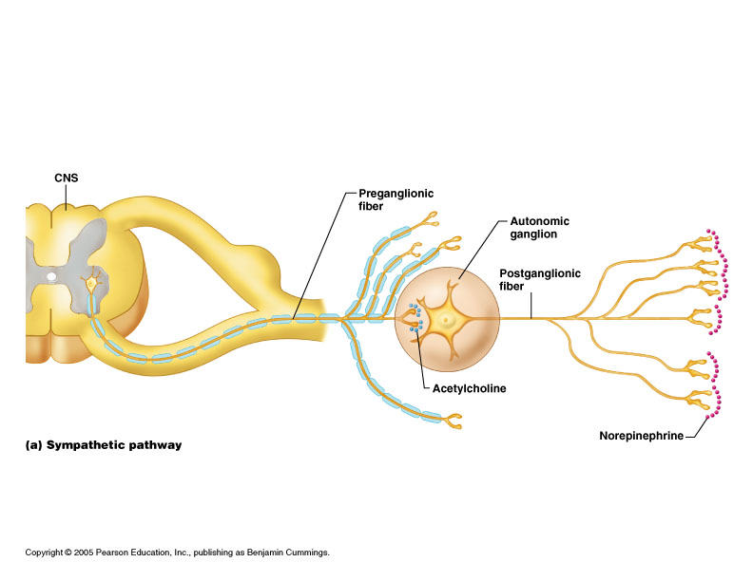
Sympathetic vs Parasympathetic

Slide 24
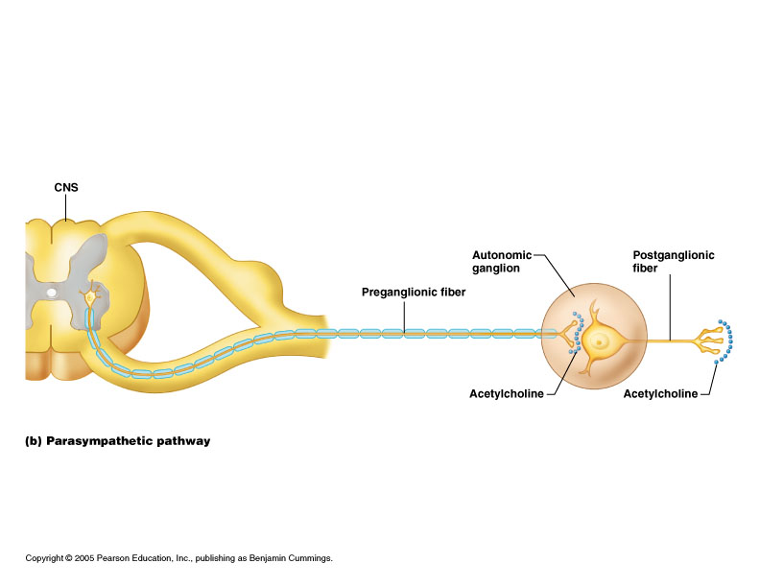
Sympathetic vs Parasympathetic

Slide 25
Autonomic neurotransmitters
All autonomic preganglionic synapses have Ach as the neurotransmitter (nicotinic receptors).
All postganglionic parasympathetic synapses have Ach as the neurotransmitter (muscarinic receptors).
Most postganglionic sympathetic synapses have NE as the neurotransmitter (adrenergic receptors).
Sympathetic preganglionic neurotransmitter at adrenal medulla is Ach (nicotinic receptor) → release of Epi. and NE (80/20).
Sympathetic postganglionic neurotransmitter at sweat glands is Ach (muscarinic receptors).

Slide 26
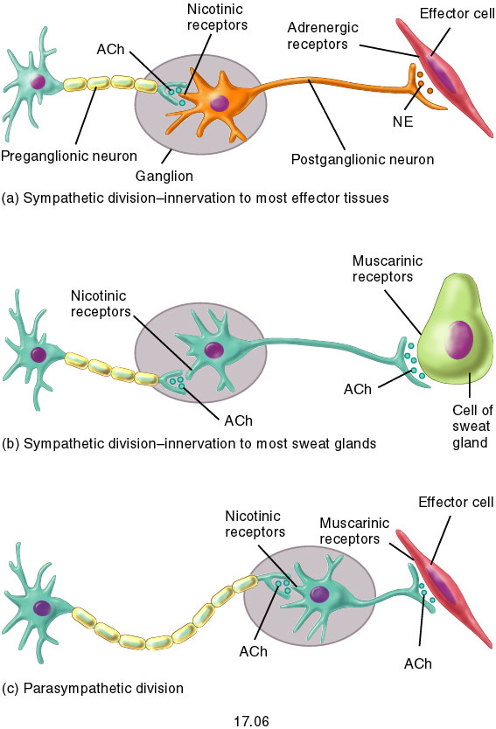
Autonomic neurotransmitters

